Slide 1
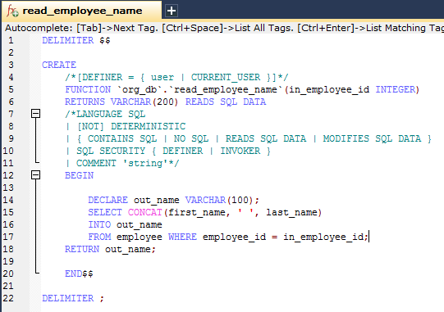
Calling a stored function using SimpleJdbcCall
The in_employee_Id parameter contains the id of the employee you are looking up.
The out parameters return the data read from the table.

Slide 2
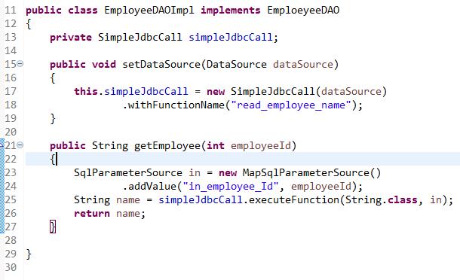
Calling a stored function using SimpleJdbcCall
You call a stored function in almost the same way as you call a stored procedure, except that you provide a function name rather than a procedure name.
You use the withFunctionName method as part of the configuration to indicate that we want to make a call to a function, and the corresponding string for a function call is generated.
A specialized execute call, executeFunction, is used to execute the function and it returns the function return value as an object of a specified type, which means you do not have to retrieve the return value from the results map. A similar convenience method named executeObject is also available for stored procedures that only have one out parameter.

